Slide 1
Understanding Neurodiversity
Ian Collings
Consultant Psychiatrist, SBUHB
Director of Medic Professional Support & Development, Medical Deanery, HEIW
@DrICollings

Slide 2
What is neurodiversity?

Slide 3
Key takeaways
Definition and classification
Autism, Dyslexia and ADHD
Epidemiology and features
Strengths of the neurodiverse brain
Challenges for neurodiverse medical trainees
Adjustments for neurodiverse trainees
Notes:
Leona

Slide 4
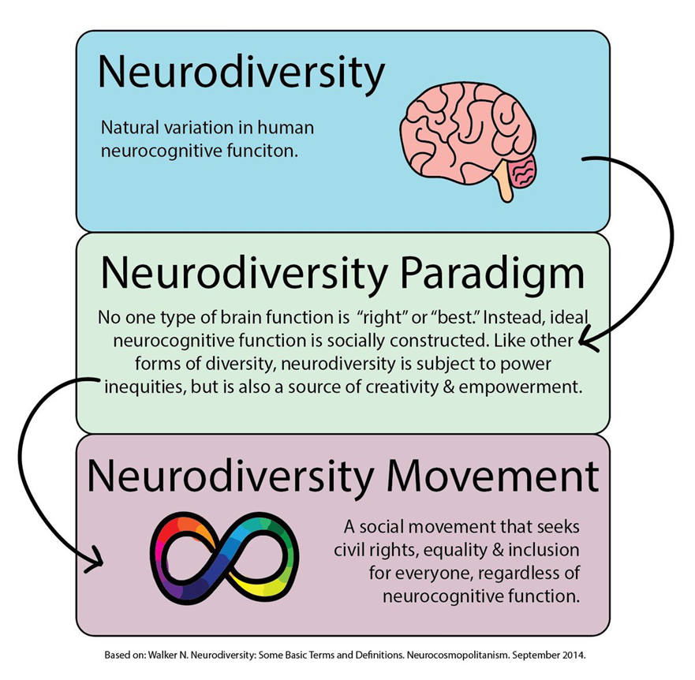
What is neurodiversity
Notes:
Leona

Slide 5
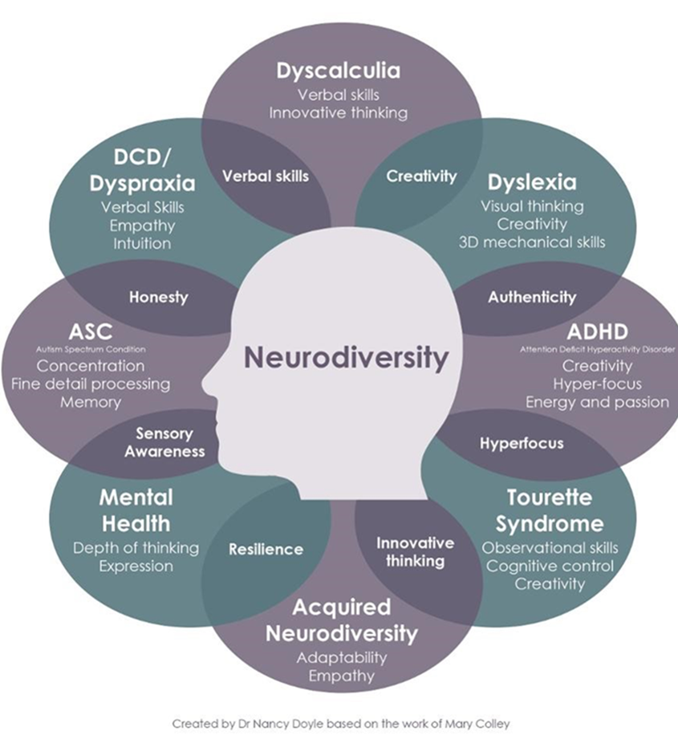
Neurodiversity – classification
Notes:
Ian

Slide 6
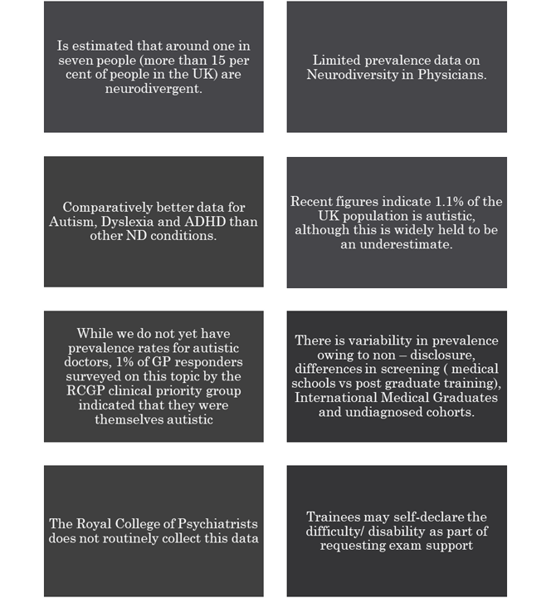
Neurodiversity - prevalence

Slide 7
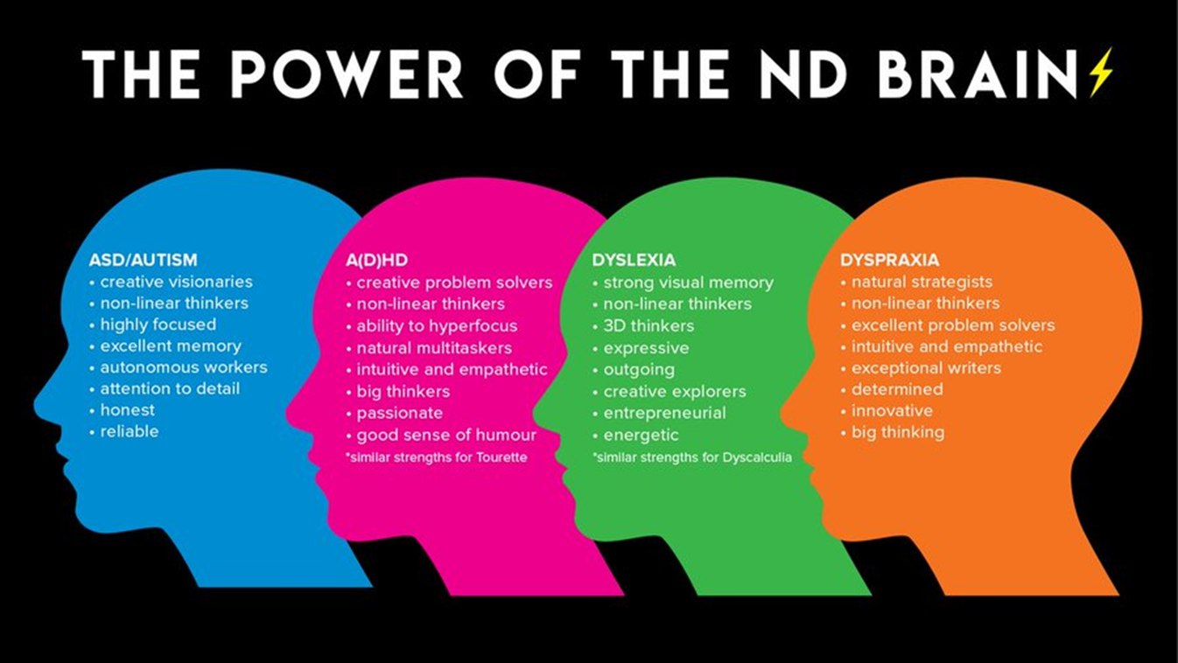
Notes:
Ian

Slide 8
Dyslexia
Specific learning difficulty that mainly affects development of literacy and language related skills
SpLD that impairs people’s abilities around reading texts despite them having normal intelligence (National Institute of Neurological Disorders and Stroke, 2011)
UK prevalence 5-10%, 4:1 M:F
Employers should ensure they are not treated unfavourably and are offered reasonable adjustments or support. (Equality Act 2010)
Educational psychologist makes diagnosis

Slide 9
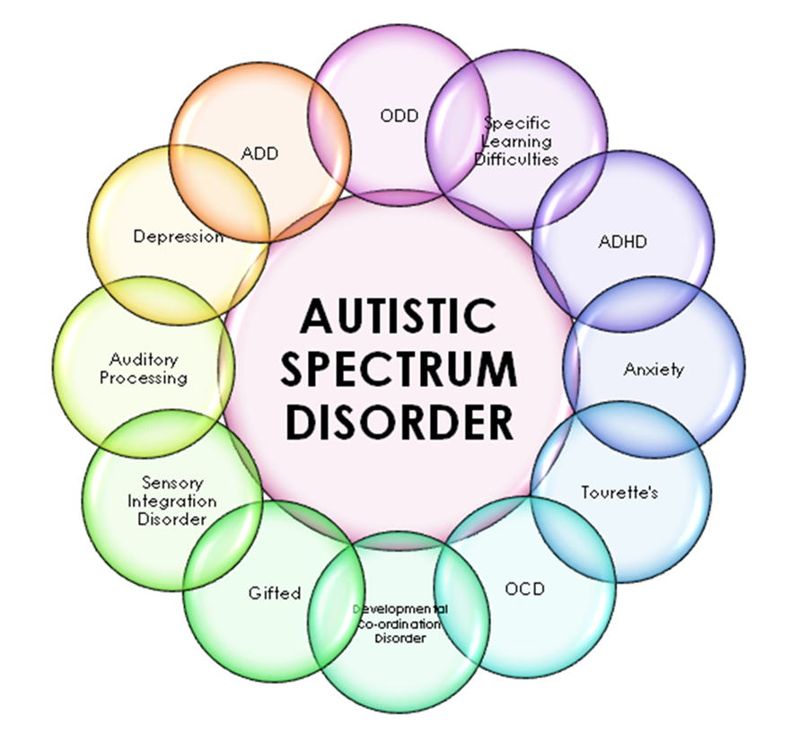

Slide 10
Autism
Persistent deficits in social communication & social interaction
Restricted, repetitive patterns of behaviour, interests, or activities
Symptoms must be present in the early developmental period
Symptoms cause clinically significant impairment in social, occupational, or other important areas of current functioning

Slide 11
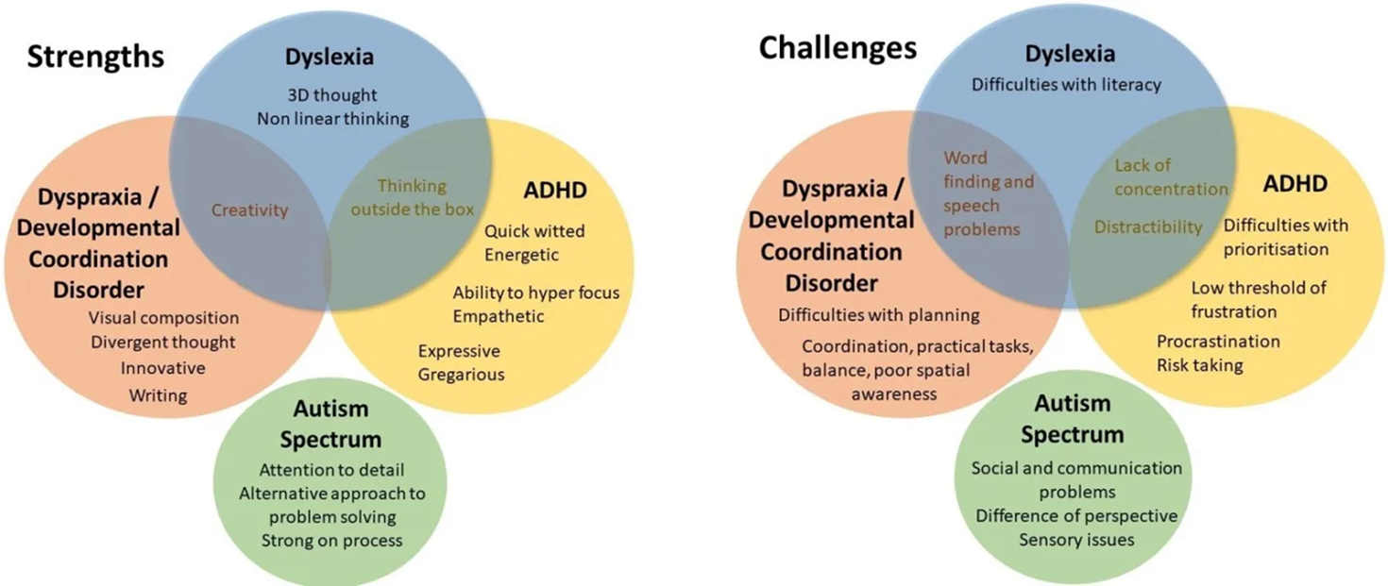

Slide 12
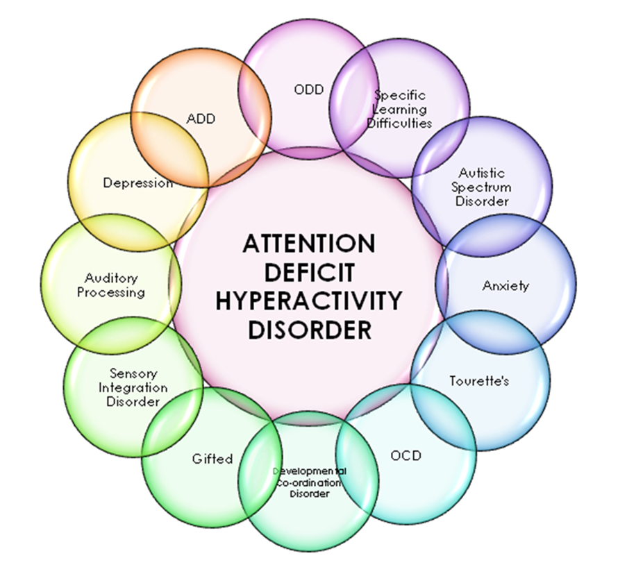

Slide 13
ADHD
2-6% prevalence
Continuation of childhood disorder
Co-morbidity with dyslexia
Core features
Inattention
Impulsivity
Hyperactivity
M=F

Slide 14
How can trainees struggle with ADHD
Internal restlessness
Ceaseless thought processes
Inability to focus on tasks
Forgetfulness
Time keeping issues
Poorly controlled affect
Low self esteem
Sleep issues
Notes:
Leona

Slide 15
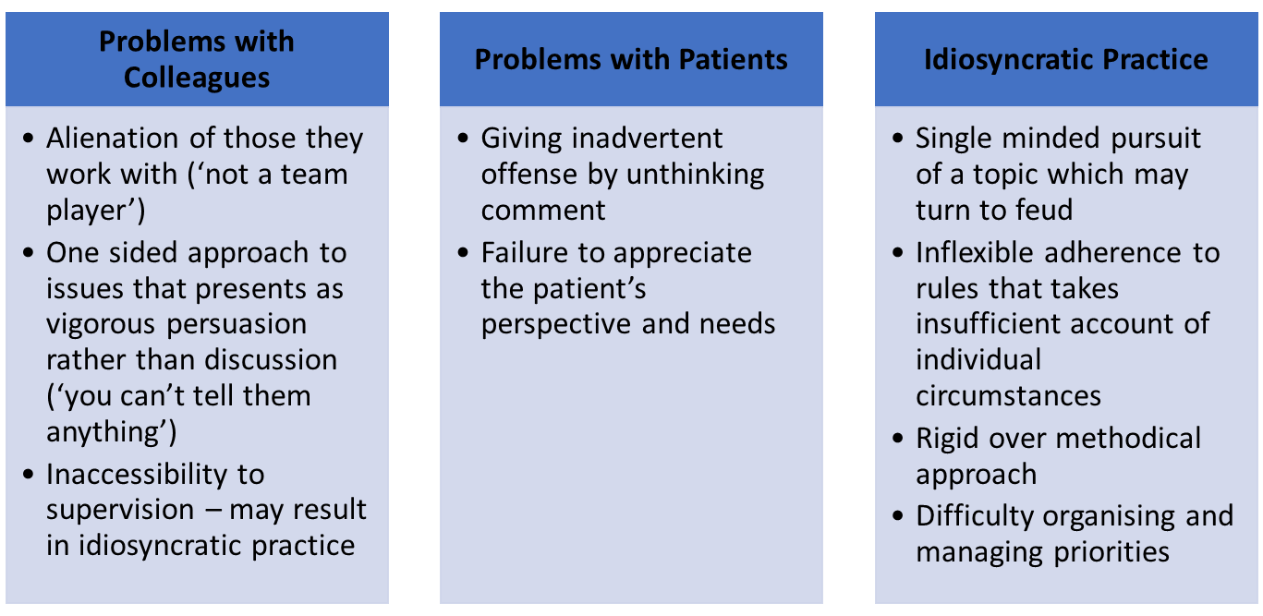
How can ND impact training

Slide 16
Lived experience commentary by Shirley Moore
I graduated from university with honours and prizes, yet 10 years later found myself dismissed from employment in the National Health Service following my long-term absence with depression and anxiety. I had no idea I was autistic. With increased understanding of my different thought processes and sensory sensitivities, it is clear now why I struggled as a foundation doctor and why these problems escalated as I progressed into speciality training, married, and had children, with the increasing requirement to multitask and adapt to unexpected change.
I always felt I was working far harder than my peers simply to keep afloat. I needed details and explanations that were unnecessary to others and took longer to become confident in procedures and my own abilities. I felt stupid. Appearing normal was exhausting, but I still felt like I was an outsider and did not fit in with peers and colleagues.
Discovering that there was a biological reason to why I was obviously intelligent but struggled with seemingly simple things finally helped me to understand, and accept, my differences. Receiving support specific to ASD and connecting with other autistic adults, including doctors, has helped me to reframe my experiences, increase my self-esteem, better manage my energy levels, and have the confidence to ask for necessary adjustments (appendix).
I am currently pursuing new avenues in psychotherapy, but, had my autism been understood and supported sooner, I believe a successful medical career would have been possible for me, as it is for others on the autistic spectrum.
Moore, S., Kinnear, M. and Freeman, L. (2020). Autistic doctors: overlooked assets to medicine. The Lancet Psychiatry, 7(4), pp.306–307.
Notes:
Leona

Slide 17
Workplace adjustments
Work environment flexibility
Noise cancelling headphones
Flexible working hours to reduce sensory distraction
Schedule flexibility
Avoiding rush hour traffic
Remote working
Supervisor/colleagues
Additional time for feedback
Different in approach to given instructions
Notes:
Leona

Slide 18
Workplace adjustments
Other support structures
Peer mentoring
Access to third sector
Executive functioning coaching
Support with planning and prioritisation
Training
Additional induction time
Sending learning materials in advance
Notes:
Leona

Slide 19
Workplace adjustments
Desk/workstation
Dual screen
Standing desks
Whiteboards or other aide memoires
Assistive tech
Speech to text
Mind mapping software
Specialist spellcheckers
Notes:
Leona

Slide 20
Trainer resources
https://www.dgeducationcentre.co.uk/wp-content/uploads/2017/03/Doctors-with-Dyslexia-Advice-for-Supervisors.pdf
Recognising human variation (bma.org.uk)
BMA DLN network
bjgpmay2014-64-622-252.pdf (nih.gov)
Neurodiversity at work: a biopsychosocial model and the impact on working adults (nih.gov)
Guidance for identification and treatment of individuals with attention deficit/hyperactivity disorder and autism spectrum disorder based upon expert consensus - PubMed (nih.gov)
Notes:
Ian

Slide 21
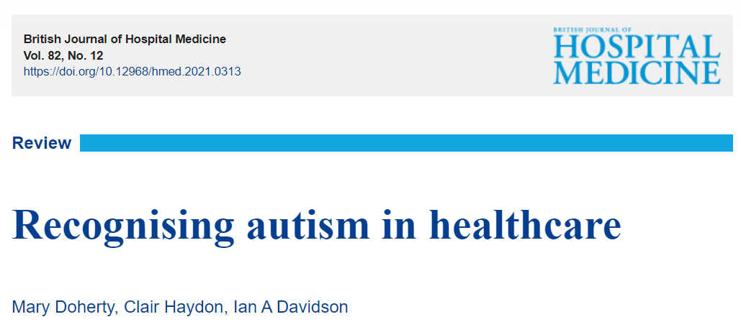
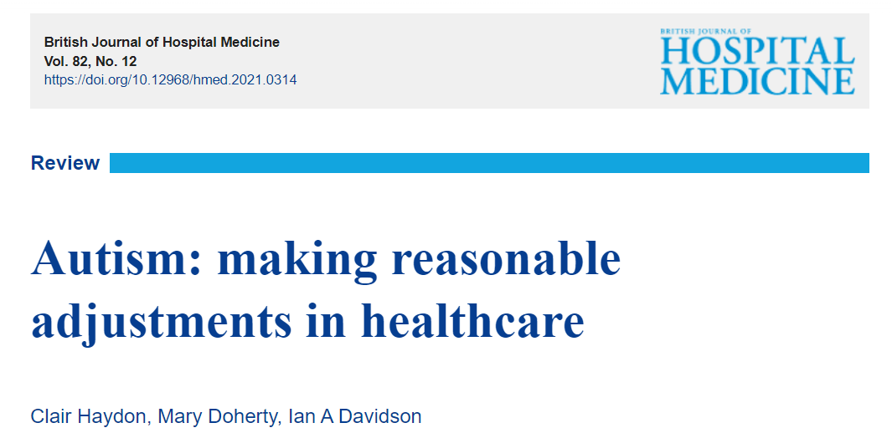
References and further reading
https://www.magonlinelibrary.com/doi/full/10.12968/hmed.2021.0313
https://www.magonlinelibrary.com/doi/full/10.12968/hmed.2021.0314
Notes:
Ian

Slide 22
Contact your local PSU
Professional Support Unit
Health Education and Improvement Wales (HEIW) Ty Dysgu, Cefn Coed, Nantgarw. CF15 7QQ UK
Phone +44(0) 3300584211
Email HEIW.professionalsupport@wales.nhs.uk
Notes:
Ian

Slide 23
